Slide 1

VIJAYA VITTALA INSTITUTE OF TECHNOLOGY
DEPARTMENT OF COMPUTER SCIENCE AND ENGINEERING
INTERNSHIP PRESENTATION
BACKEND DEVELOPER
Submitted By
MOHAMMED JABIR
[1VJ19CS034]
Internship Carried Out
At
HQV TECHNOLOGIES
Internal Guide
Prof. Kavita B.E., M.Tech,( )
External Guide
Mr. Mohammed Viqar Ahmed

Slide 2
CONTENTS
About The Company
Introduction
Task Performed
Reflection Notes
References

Slide 3

ABOUT THE COMPANY
HQV Technologies Private Limited is a Private incorporated. It is classified as Non-govt Company and is registered at Registrar of Companies, Bangalore..
HQV Technologies focus on providing quality education on the latest technologies and developing much-needed products for society.
They are continuously involved in researching future technologies and finding ways to simplify them for our customers.
They operate project consultants who undertake a variety of projects from a variety of clients, assist in designing and manufacturing products, and provide services. .

Slide 4
ABOUT THE COMPANY
Company Details
Company Name | HQV Technologies Private Limited.
Address | No 17, Third Floor C Street, Bharathi Nagar, Bangalore – 560 001
Phone Number | +91 8892614271
Website | www.hqvtechnologies.com

Slide 5
ABOUT THE COMPANY
Vision
“To be a world-class IT Application Development Training and internship organization committed to helping students and providing quality services”.
Mission
“To Harness and train best brainpower to give solutions for real challenges of the world”.

Slide 6
INTRODUCTION
Introduction to Rest Apis
RESTful API is an interface that two computer systems use to exchange information securely over the internet
A RESTful API is an architectural style for an application program interface (API) that uses HTTP requests to access and use data.
REST APIs are web services that use HTTP and provide an interface for clients to interact with the service.
One of the key advantages of REST APIs is that they provide a great deal of flexibility.

Slide 7
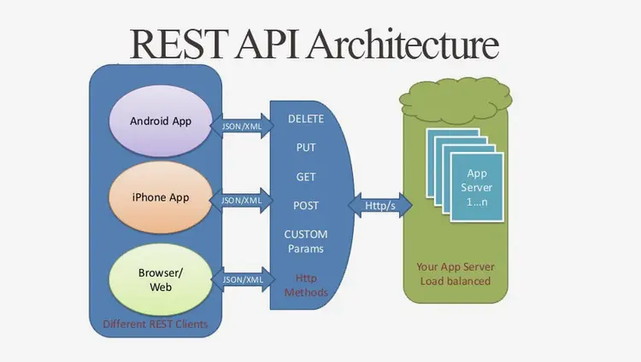
INTRODUCTION

Slide 8
INTRODUCTION
Methods of Rest Apis
GET : The most popular HTTP method, GET, returns a representative view of the information and data contained in a resource.
POST : POST is the sole HTTP method for RESTful APIs that focuses on resource collections.
PUT : PUT is the most popular technique for updating resource data in a RESTful API.
. PATCH : Another HTTP method for updating resources is PATCH. PATCH alters resource contents instead of replacing resources, like the PUT method.
DELETE : Targeting a single resource with a DELETE method results in the complete deletion of that resource.

Slide 9
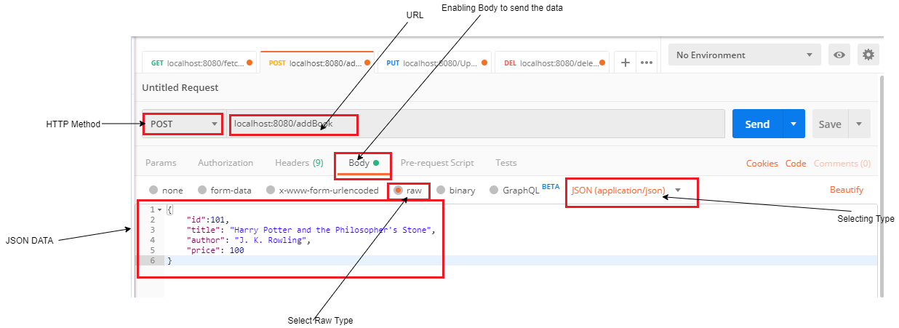
INTRODUCTION
Post Man

Slide 10
INTRODUCTION
How can I test my rest API?
Steps to test RESTful API
Open Advanced REST Client. Install Advanced REST Client. ...
Enter the URL of the API you wish to test in the textbox.
Select HTTP method in API testing, for example POST.
Give Headers set in the Headers textbox. ...
Click USE THIS SET.
Provide body content. ...
Submit the details to start testing.

Slide 11
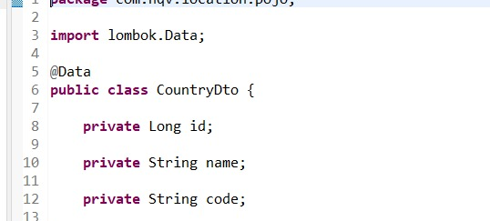
TASK PERFORMED
Implementation

Slide 12
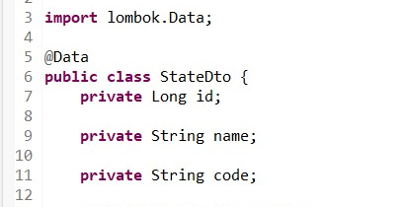
TASK PERFORMED

Slide 13
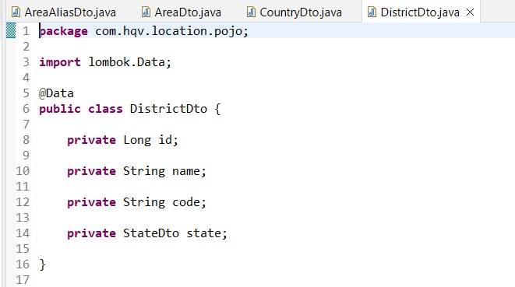
TASK PERFORMED

Slide 14
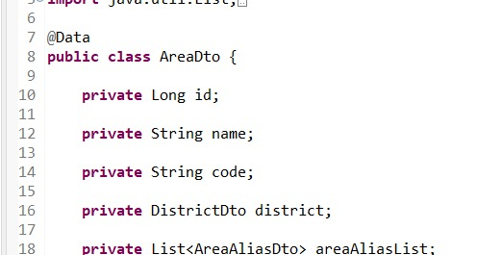
TASK PERFORMED

Slide 15
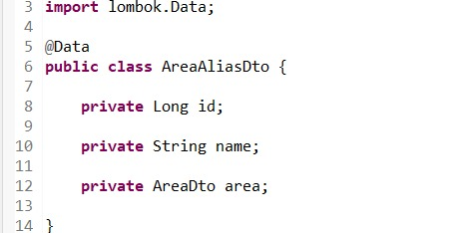
TASK PERFORMED

Slide 16
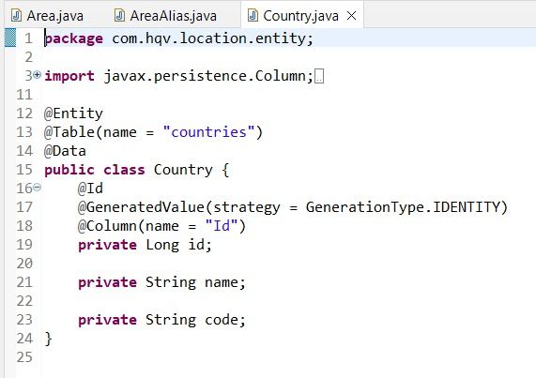
TASK PERFORMED

Slide 17
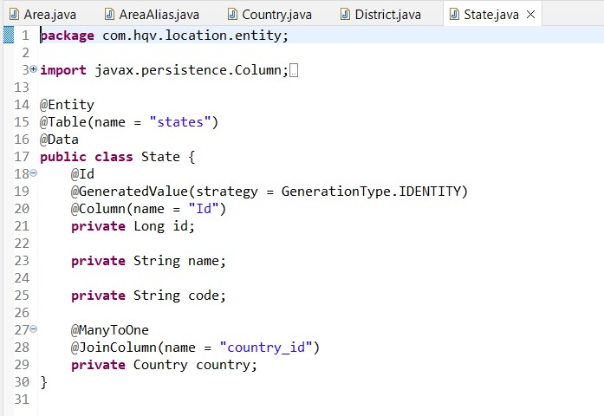
TASK PERFORMED

Slide 18
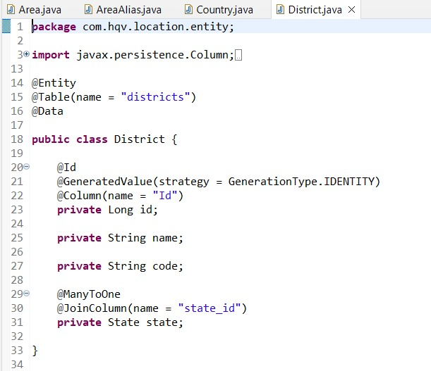
TASK PERFORMED

Slide 19
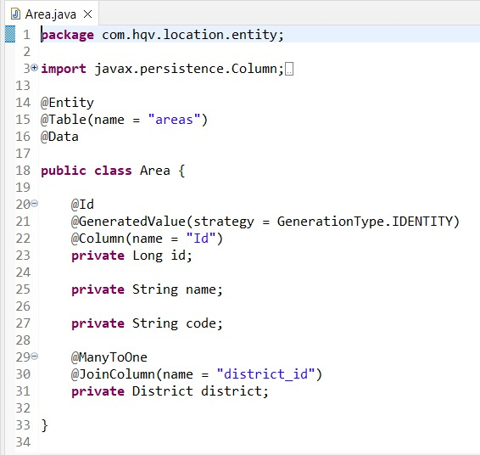
TASK PERFORMED

Slide 20
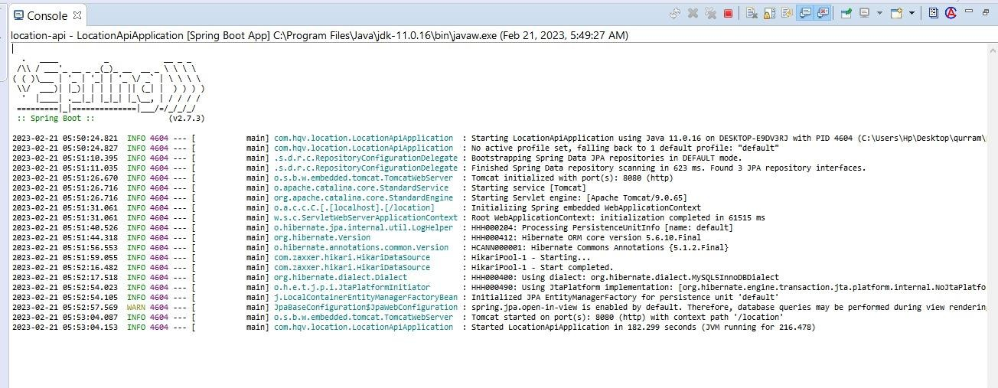
TASK PERFORMED

Slide 21
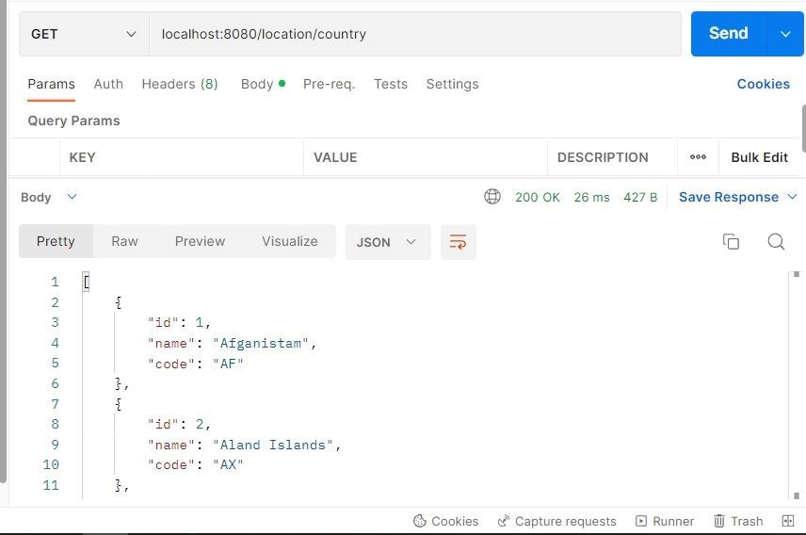
TASK PERFORMED

Slide 22
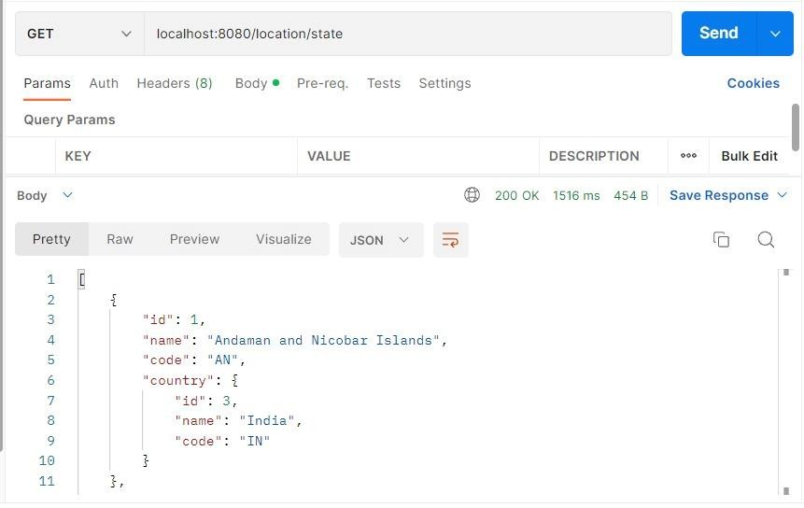
TASK PERFORMED

Slide 23
REFLECTION NOTES
. The most advantageous aspect of internships was the opportunity to get practical knowledge on different technologies.
The internship covered the concepts of back end development object oriented concepts, working with GitHub , Understanding, developing and testing API’s, and also some UI/UX design such as UI Mockup.
The internship session has been a great learning journey helping the participants in the internship program to understand the concepts of Web Development
It helped us improve our logical thinking.
It helped me to improve our communication skills.
They taught us to manage the time so that we could code maximum in limited or specified time.

Slide 24
REFERENCES
https://www.w3schools.com
https://www.wikipedia.org
https://maven.apache.org
https://www.postman.com

Slide 25
THANK YOU

